Slide 1
Bias/Variance
and
Cross-Validation
Review: Linear Regression
Overfitting and Underfitting
The Bias/Variance Tradeoff
Cross-Validation
K-fold Cross-Validation
Subset Selection of Predictors
Ryan Henning

Slide 2
Stepping back: One Goal of Data Science: Make Future Predictions
One goal is to make accurate predictions on future (unseen) data.
Define a business goal. e.g. make Tesla cars the most dependable vehicles on the market
Collect training data. e.g. Tesla cars’ event logs + historical record of parts replaced
Train a model. e.g. features: event statistics, target: time until failure
Deploy the model. e.g. monitor cars’ events in real time, send mechanics to replace parts that will soon fail
Questions!
Notes:
What are the rewards of doing something like this?
What are the risks of doing something like this?
What is the business impact if our model predicts incorrectly?
Is this a regression or a classification problem? A: could be either… but the way we chose to frame it here, it’s regression

Slide 3
Quick Review: Regression vs. Classification
(in machine learning)
What is regression?
Use features to predict real valued targets. E.g. predict future sales/revenue
What is classification?
Use features to predict categorical targets. E.g. predict yes/no, male/female, 0-9

Slide 4
Review: Linear Regression
We assume the world is built on linear relationships. Under that assumption, we can model the relationship between features and a target like this:
target
(aka, outcome)
model parameters
(aka, coefficients)
features
(aka, predictors)
sampling error
Notes:
Ask the students what each term is -- every time a new term animates in, ask how this term would be used in the Tesla cars example.
Example features:
amperage (at various points in the system)
voltage (at various points in the system)
timing information (delays between events)
oscillation information (amplitude of various frequencies-of-interest in x, y, and z directions, and at different places in the car)
The target would be time until system failure (or perhaps time until the failure of a certain component)

Slide 5
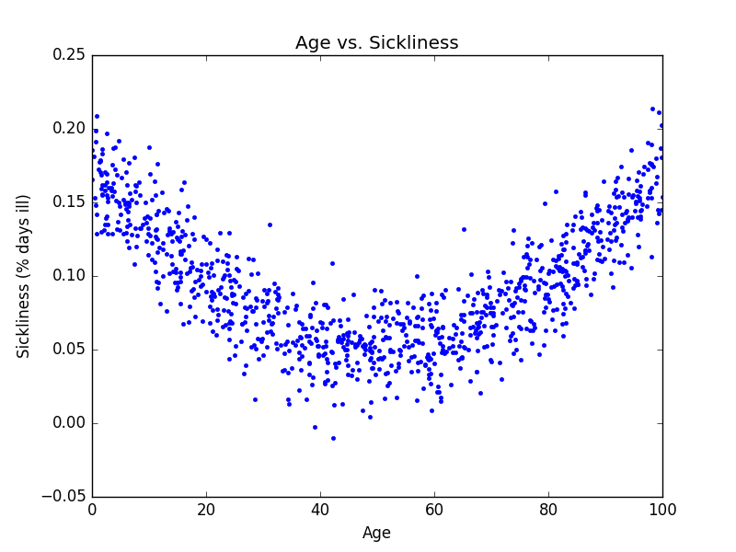



Review: Linear Regression
We can make linear regression non-linear by inserting extra “interaction” features.
Example interactions:
Notes:
import numpy as np
import numpy.random
import scipy as sp
import pandas as pd
import matplotlib as mpl
import matplotlib.pyplot as plt
x = numpy.random.rand(1000) * 100.0
y = ((x/100-0.5)**2) * 0.5 + .05 + numpy.random.normal(0, 0.02, x.shape)
plt.plot(x, y, '.')
plt.title("Age vs. Sickliness")
plt.xlabel("Age")
plt.ylabel("Sickliness (% days ill)")
plt.show()

Slide 6
Is R² all that matters?
We could just keep inserting interaction features until R² = 1.
Boom. I solved data science. Here’s my idea:
def train_super_awesome_perfect_model(X, y): while True: model = LinearRegression() model.fit(X, y) if calculate_r2(model, X, y) >= 0.999: return model else: X = insert_random_interaction_feature(X)
Why is this a bad idea?
Notes:
So are we done here? Do we have the ultimate learning model… so we can all just go home?
Too bad we can’t just do something like this. If so, being a data scientist would be so easy! Oh the woes of overfitting… let’s look at the next slide.:(

Slide 7
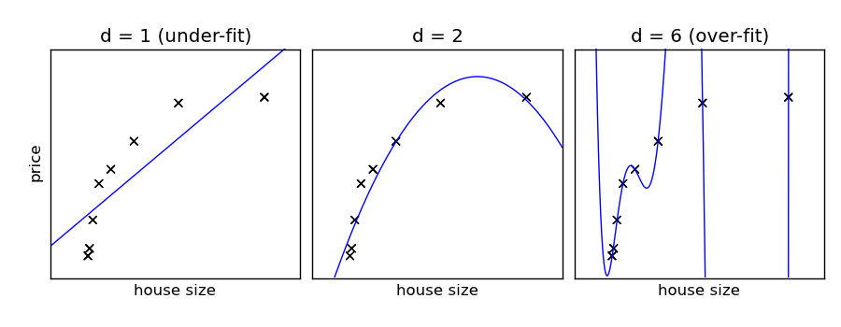
Oh the woes of overfitting...
What’s bad about the first model?
What’s bad about the second model?
What’s bad about the third model?
Y
X
X
X

Slide 8
Underfitting and Overfitting
Underfitting: The model doesn’t fully capture the relationship between predictors and the target. The model has not learned the data’s signal.
→ What should we do if our model underfits the data?
Overfitting: The model has tried to capture the sampling error. The model has learned the data’s signal and the noise.
→ What should we do if our model overfits the data?

Slide 9
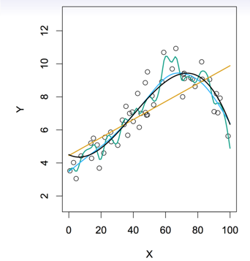
The Bias/Variance Tradeoff
Boardwork…
Let’s get an intuitive feel for the bias and the variance of a model… we’ll see more math on the next slide.
Note: Bias and Variance are terms you will use A TON as a data scientist! Exciting times!
Notes:
Draw on the whiteboad here.
Start by talking about how a dataset is just a sample of a population. We could (if we wanted) re-sample the population and get a different dataset. Draw two example. Model the dataset of the population shown in the chart on the right on this slide.
Start with a dataset like the one shown in the chart on the right. Fit a high-variance model by hand. Now draw another dataset from the same population, and fit another high-variance model. Define what we mean by the variance of a model!
Now draw yet another dataset from the same population. Fit a high-bias model by hand. Now draw yet another detaset from the same population, and fit another high-bias model. Define what we mean by the bias of a model!
These are two terms you’ll use all the time as a data scientist!

Slide 10

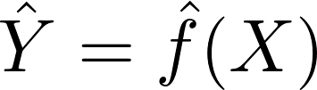
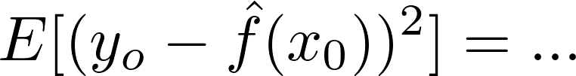
The Bias/Variance Tradeoff
We assume the true predictor/target relationship is given by an unknown function plus some sampling error:
We estimate the true (unknown) function by fitting a model over the training set.
Let’s evaluate this model using a test observation (x₀, y₀) drawn from the population. What is the model’s expected squared prediction error on this test observation?
Notes:
The true function f is the black line in our boardwork. Of course in real life you don’t know what the true f is, or else you wouldn’t be fitting a model!
The function f hat is our model. So, we use our model to approximate true f and make predictions of the y -- estimates of y.
We are interested in knowing the expected squared prediction error. This is basically MSE… just written as an expectation. We’ll expand this equation on the whiteboard.

Slide 11
The Bias/Variance Tradeoff
Our model’s expected squared prediction error will depend on (1) the variability of y₀ and (2) the variability of the training set used to train our model. We can break this into three pieces:
The variance of the irreducible error.
The variance of our model’s prediction of x₀ over all possible training sets
The difference between the true prediction and our model’s average prediction over all possible training sets
Notes:
E[(y_o - \hat{f}(x_0))^2] = ... = \text{Var}(\hat{f}(x_0)) + \text{Bias}^2(\hat{f}(x_0)) + \text{Var}(\epsilon)

Slide 12
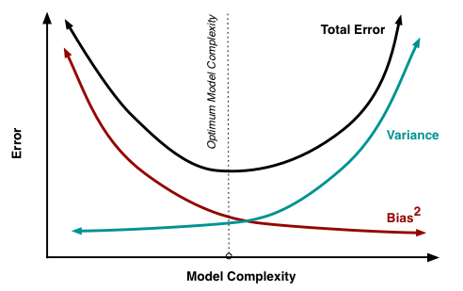
The Bias/Variance Tradeoff
How is the
bias/variance tradeoff
related to
underfitting and overfitting?
How can we find the best tradeoff point?
I.e. The optimum model complexity
Notes:
Unfortunate for humanity, but fortunate for us, training models requires both algorithms AND a data scientist (a human). The algorithms aren’t good enough (yet) to sort through the data and find the best fit, the most obvious patterns that affect the business, etc. The scientist has to be there. As a scientist, you better know about the bias/variance tradeoff. To get the most optimal model, your intuition will play a huge roll. Knowing about this tradeoff will help you identify ways to improve the performance of your model.

Slide 13

Cross-Validation
Main idea: Don’t use all your data for training.
Instead: Split your data into a “training set” and a “validation set”.
randomize!
(why?)
training set
validation set
where to split?

Slide 14
Cross-Validation
Split your data into training/validation sets. 70/30 or 90/10 splits are commonly used
Use the training set to train several models of varying complexity. e.g. linear regression (w/ and w/out interaction features), neural nets, decision trees, etc. (we’ll talk about hyperparameter tuning, grid search, and feature engineering later)
Evaluate each model using the validation set. calculate R², MSE, accuracy, or whatever you think is best
Keep the model that performs best over the validation set.
Notes:
How to choose training/validation split? Well, the key is really to ensure the validation set is large enough to give you significant results. That depends on the variability of your sample and also the number of samples you have available.

Slide 15
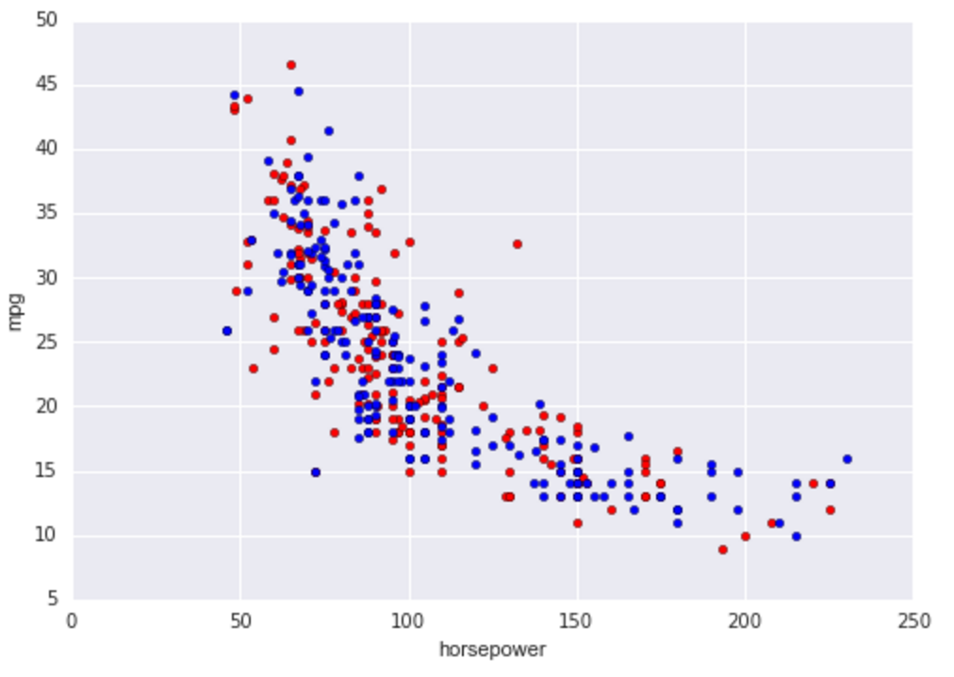
Let’s predict MPG from horsepower
blue: training set
red: test set

Slide 16
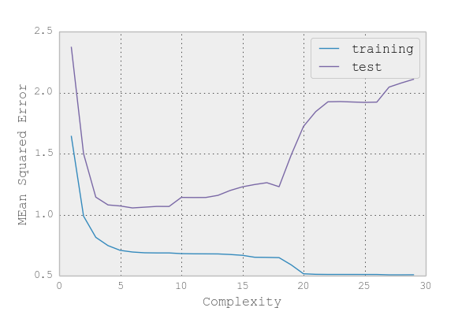
Cross-Validation Example
You will see this shape all the time!
You will wrestle with the bias/variance tradeoff constantly...
linear regression w/ varying degree of polynomial

Slide 17
Recall our goal: Making accurate future predictions
Fitting the training set perfectly is easy.
How?
Fitting future (unseen) data is not easy.
Cross validation helps us choose a model that performs well on unseen data.

Slide 18
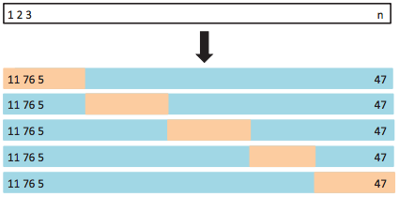
k-Fold Cross-Validation
Commonly, k=5 or k=10
randomize!
Split the dataset into k “folds”.
Train using (k-1) folds. Validate using the one left-out fold. Record a validation metric such as RSS or accuracy.
Train k models, leaving out a different fold for each one.
Average the validation results.

Slide 19
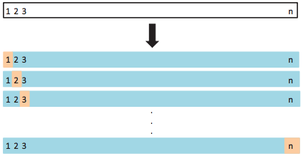
Leave-one-out Cross-Validation
Assume we have n training examples.
A special case of k-fold CV is when k=n. This is called leave-one-out cross-validation.
Useful (only) if you have a tiny dataset where you can’t afford a large validation set.

Slide 20
Overfitting in high dimensions is easy, even with simple models.
If our data has high dimensionality (many many predictors), then it becomes easy to overfit the data.
This is one result of the so-called Curse of Dimensionality (look it up).
Even linear regression might be too complex of a model for high dimensional data (and the smaller the dataset, the worse this problem is).
Linear regression in high dimensions

Slide 21
“HELP, my model is overfitting!”
You have a few options.
Get more data… (not usually possible/practical)
Subset Selection: keep only a subset of your predictors (i.e, dimensions)
Regularization: restrict your model’s parameter space
Dimensionality Reduction: project the data into a lower dimensional space

Slide 22
Subset Selection
Best subset: Try every model. Every possible combination of p predictors
Computationally intensive. 2^{p} possible subsets of p predictors
High chance of finding a “good” model by random chance. … A sort-of monkeys-Shakespeare situation …
Stepwise: Iteratively pick predictors to be in/out of the final model.
Forward, backward, forward-backward strategies

Slide 23
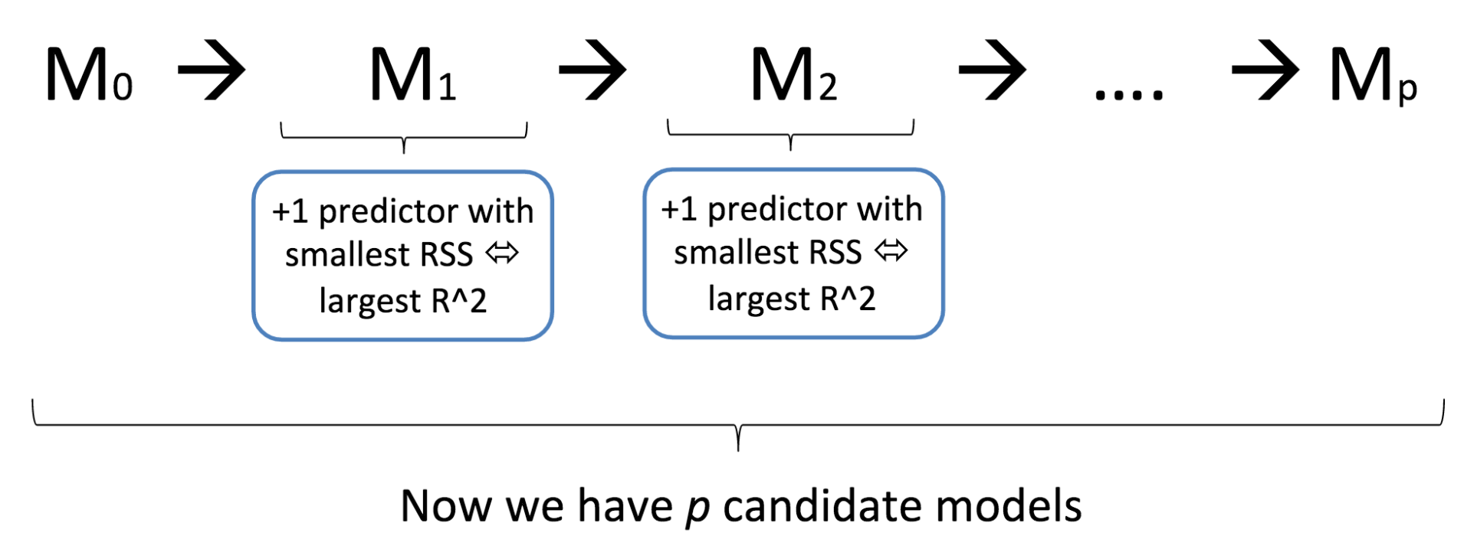
Forward Stepwise Selection
Are RSS and R² good ways to decide amongst the resulting (p+1) candidates?
Answer: Don’t use RSS or R² for this part.
Use Mallow’s C_{p}, or AIC, or BIC, or Adjusted R².
… or just use cross-validation with any error measurement.

Slide 24
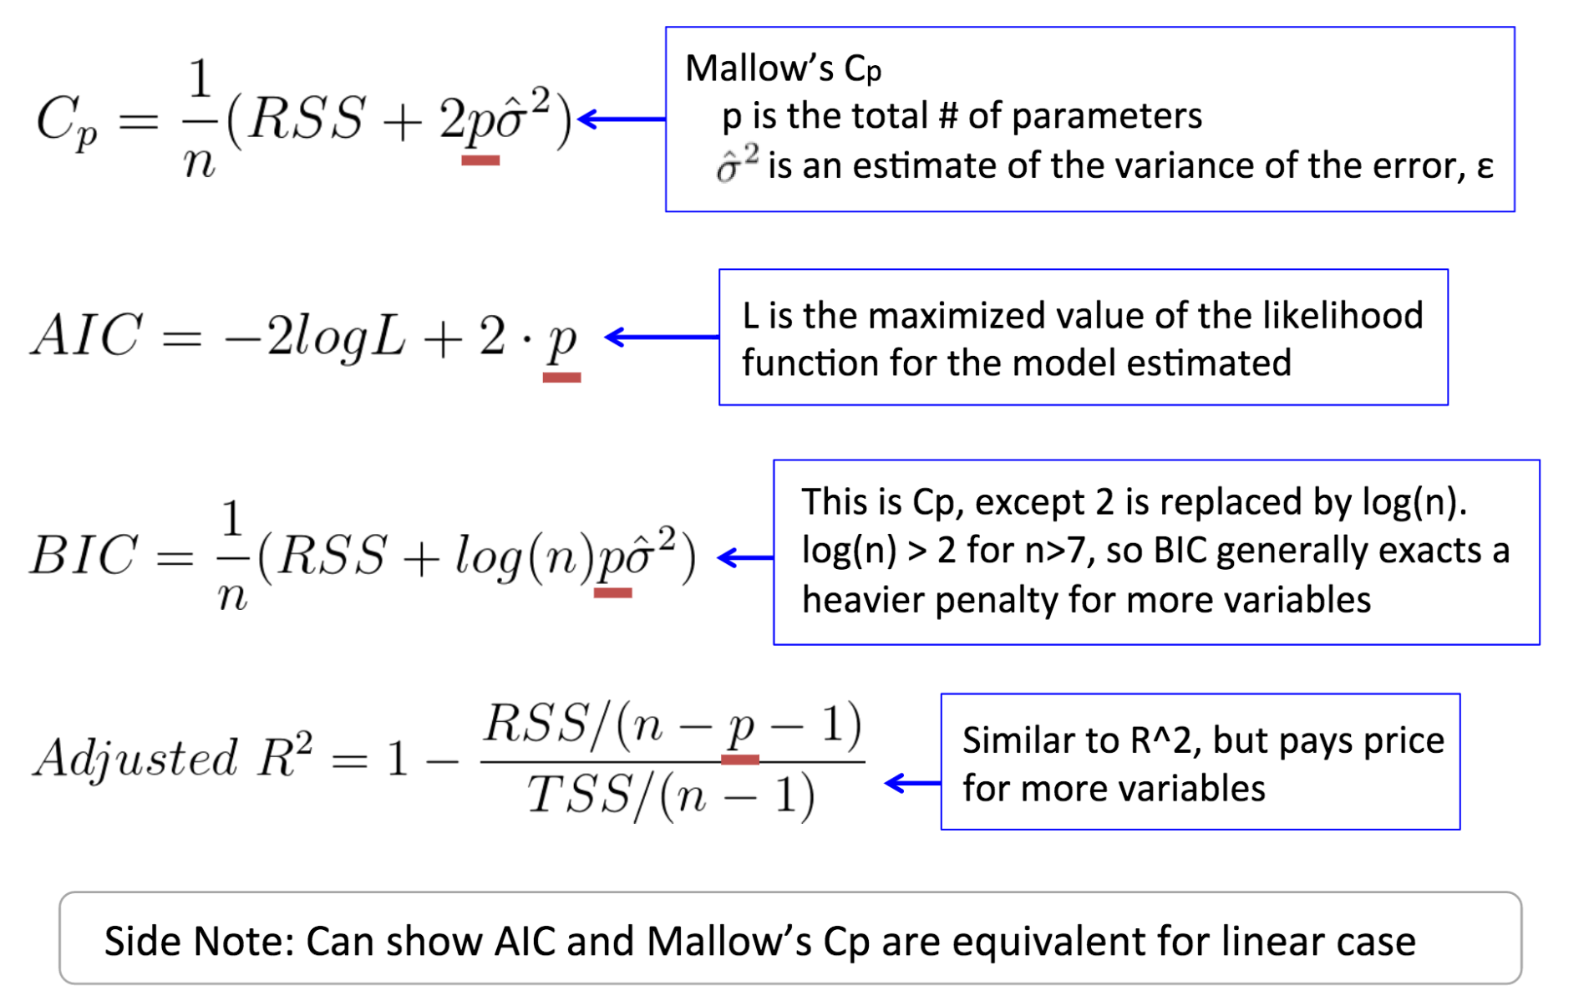
Subset Selection: Comparing models of varying number of predictors...

Slide 25
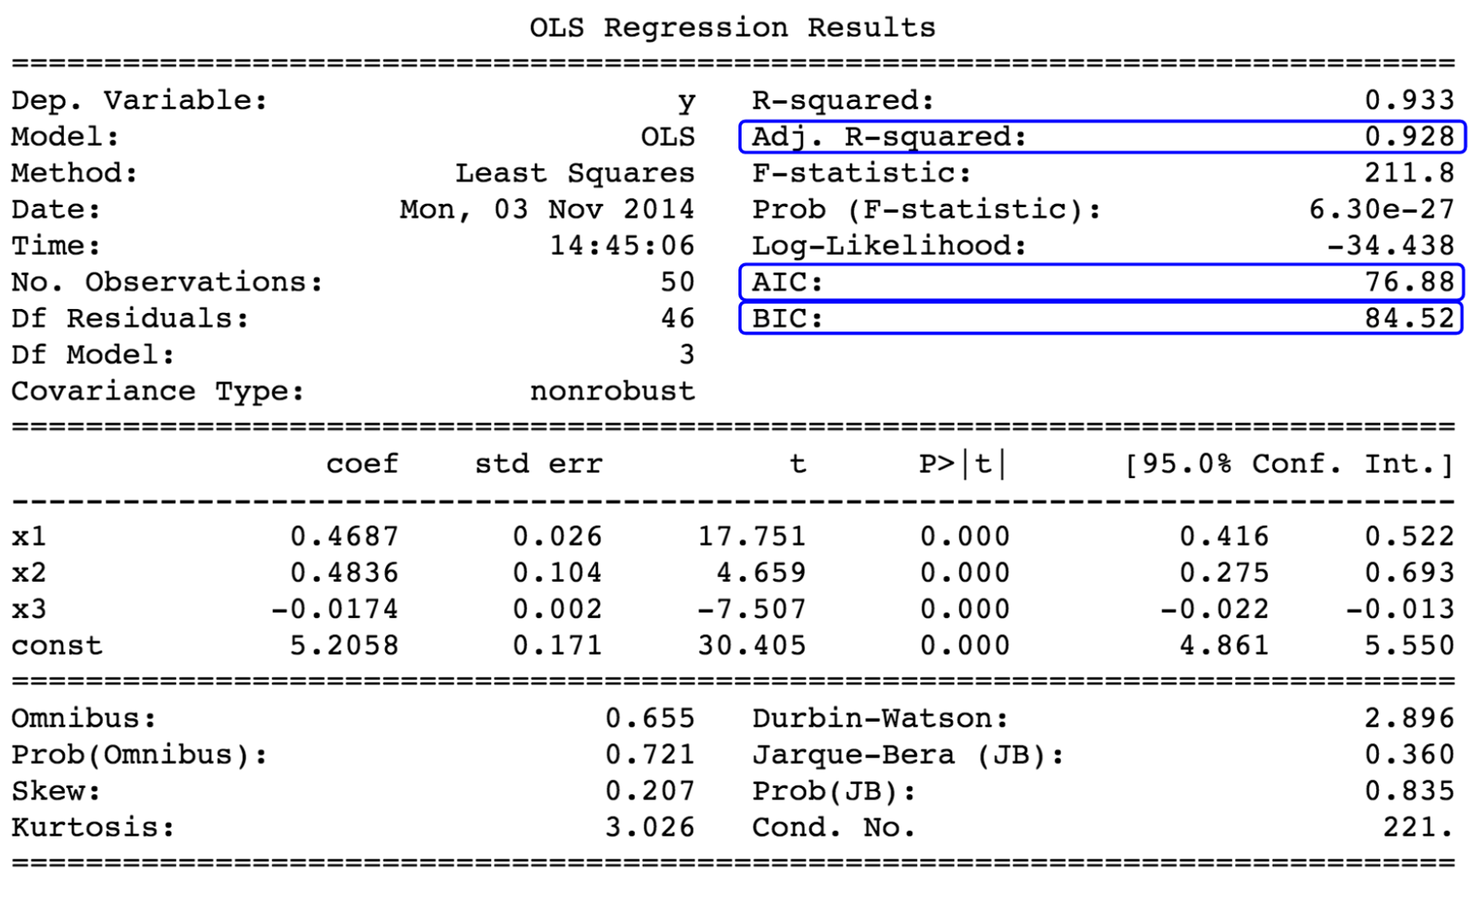
Subset Selection: Comparing models of varying number of predictors...

Slide 26
Regularization
Shortcomings of Ordinary Linear Regression
Ridge Regression
Lasso Regression
When to use each!
Ryan Henning

Slide 27
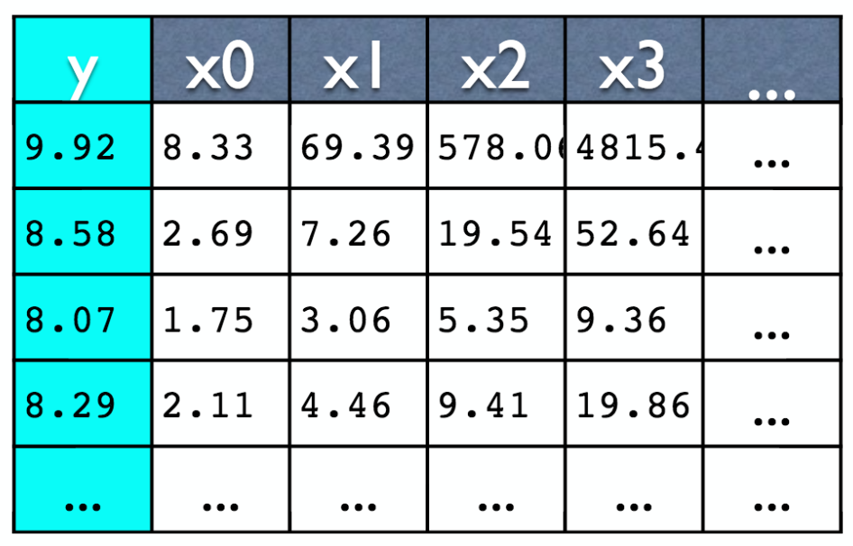
Linear Regression Example
Data: 20 examples x 10 features
Predict: y

Slide 28
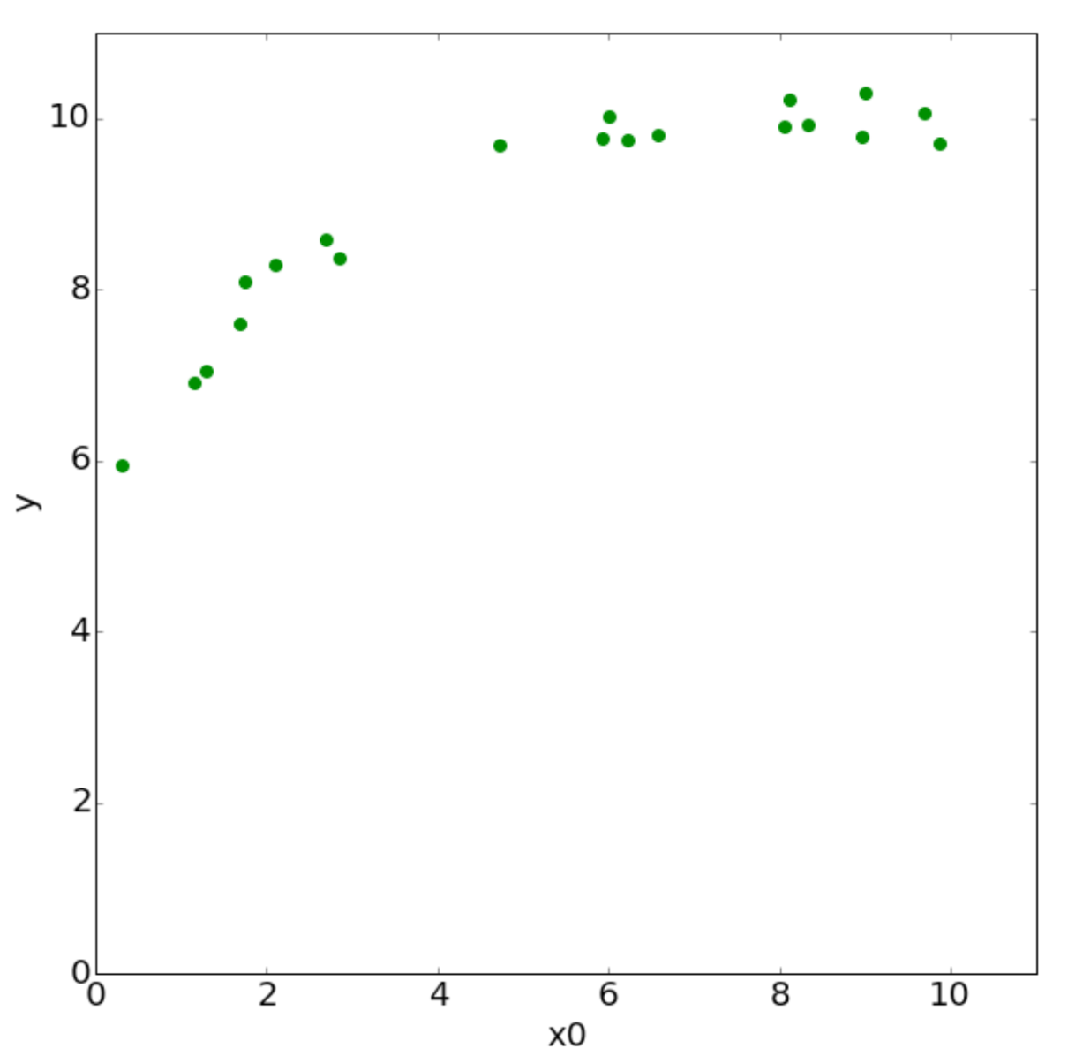
Linear Regression Example (x0 vs y)

Slide 29
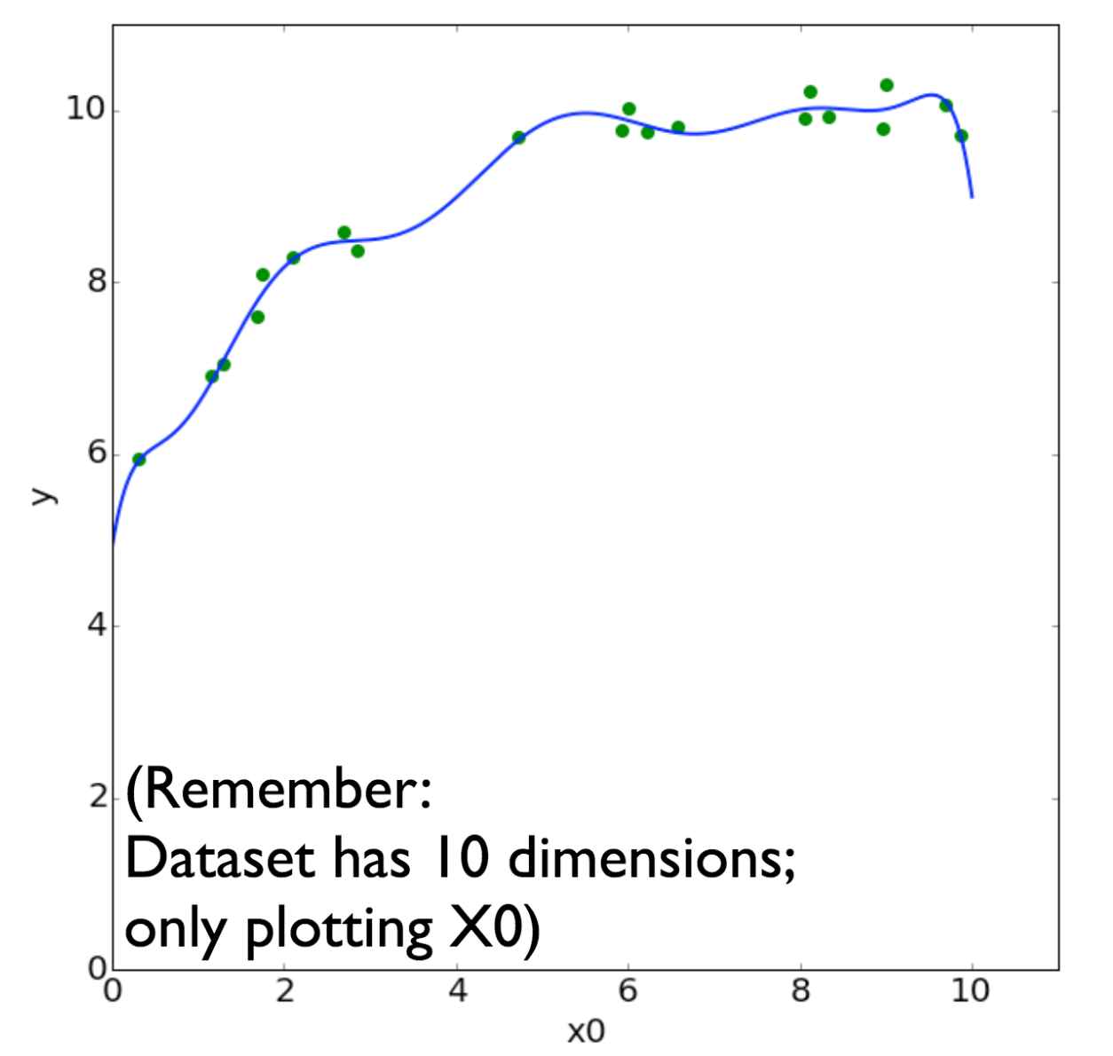
Linear Regression Example (x0 vs y, model over all features)

Slide 30
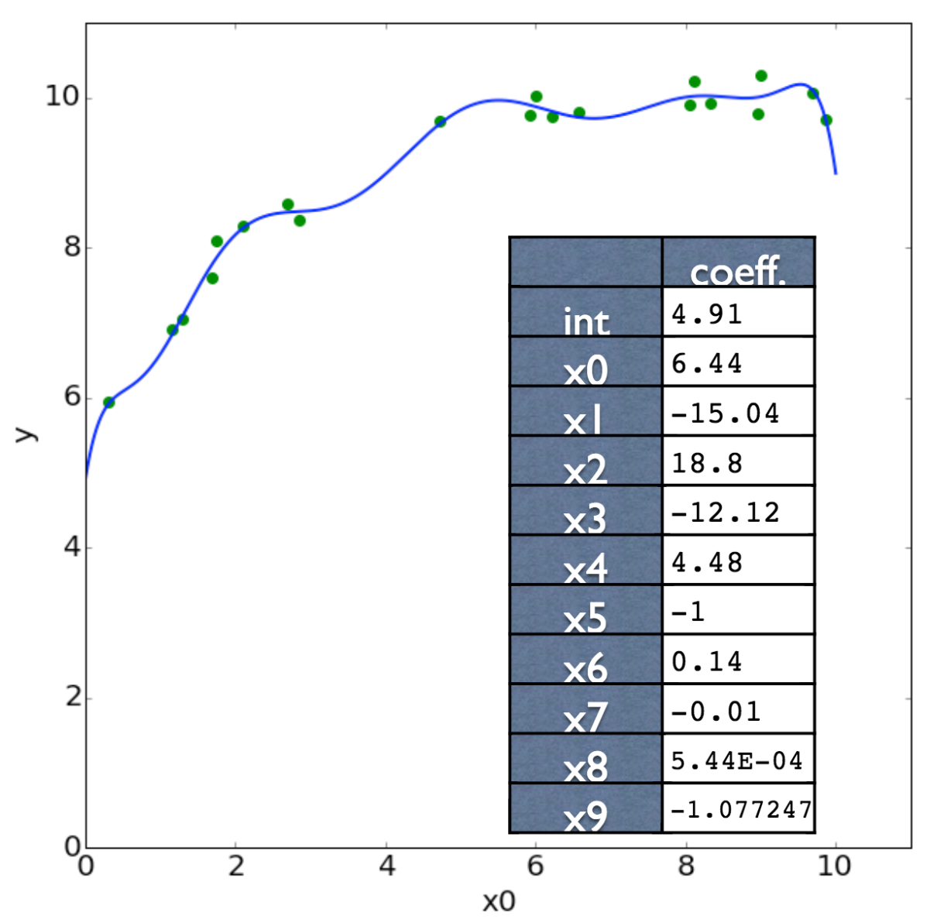
Linear Regression Example (x0 vs y, model over all features)

Slide 31
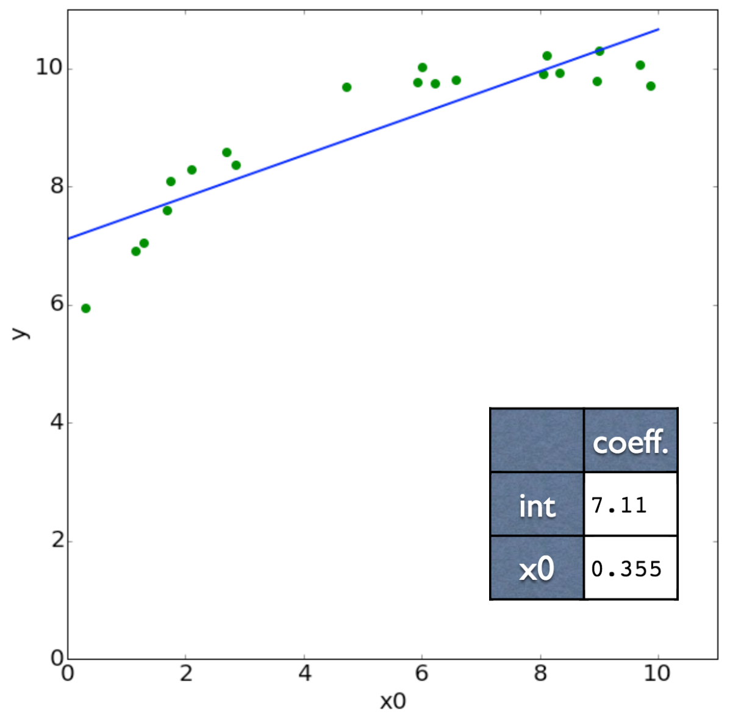
Linear Regression Example (x0 vs y, model over only x0 features)

Slide 32
In high dimensions, data is (usually) sparse
Again… the Curse of Dimensionality bites us. (we’ll talk more about this is a later lecture)
Linear regression can have high variance (i.e. tends to overfit) on high dimensional data… We’d like to restrict (“normalize”, or “regularize”) the model so that it has less variance.
Take the 20 example x 10 feature dataset as an example… when we fit over all features, the complexity of the model grew dramatically. (and keep in mind, some datasets have thousands of features)

Slide 33
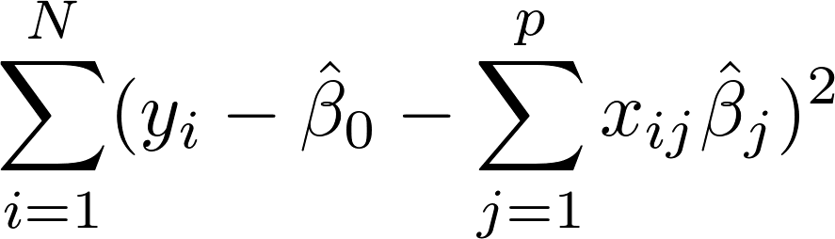
Linear Regression (another review)
We model the world as:
We estimate the model parameters by minimizing:

Slide 34
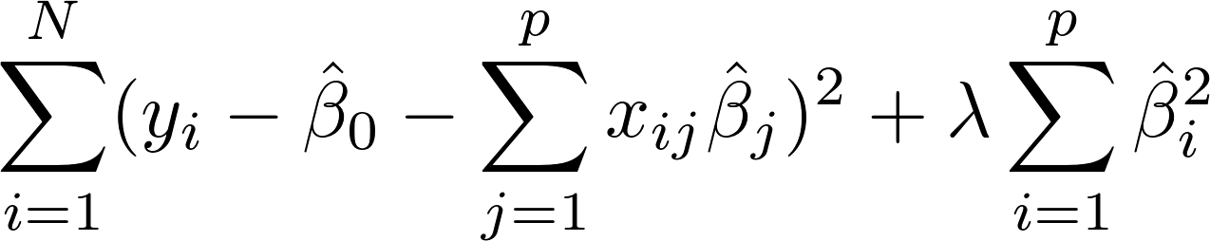
Ridge Regression
(Linear Regression w/ Tikhonov (L2) Regularization)
We model the world as:
We estimate the model parameters by minimizing:
(same as before)
(the “regularization” parameter)
(new term!)
Notes:
\sum_{i = 1}^{N} (y_i - \hat{\beta}_0 - \sum_{j=1}^{p} x_{ij} \hat{\beta}_j)^2 + \lambda \sum_{i=1}^{p} \hat{\beta}_i^2

Slide 35
Ridge Regression
What if we set the lambda equal to zero?
What does the new term accomplish?
What happens to a features whose corresponding coefficient value (beta) is zero?
Notes:
built in features selection -- features whose beta values go to zero get essentially “removed” from the dataset because they are ignored by the model

Slide 36
Ridge Regression
Notice, we do not penalize B₀.
Changing lambda changes the amount that large coefficients are penalized.
Increasing lambda increases the model’s bias and decreases its variance. ← this is cool!

Slide 37
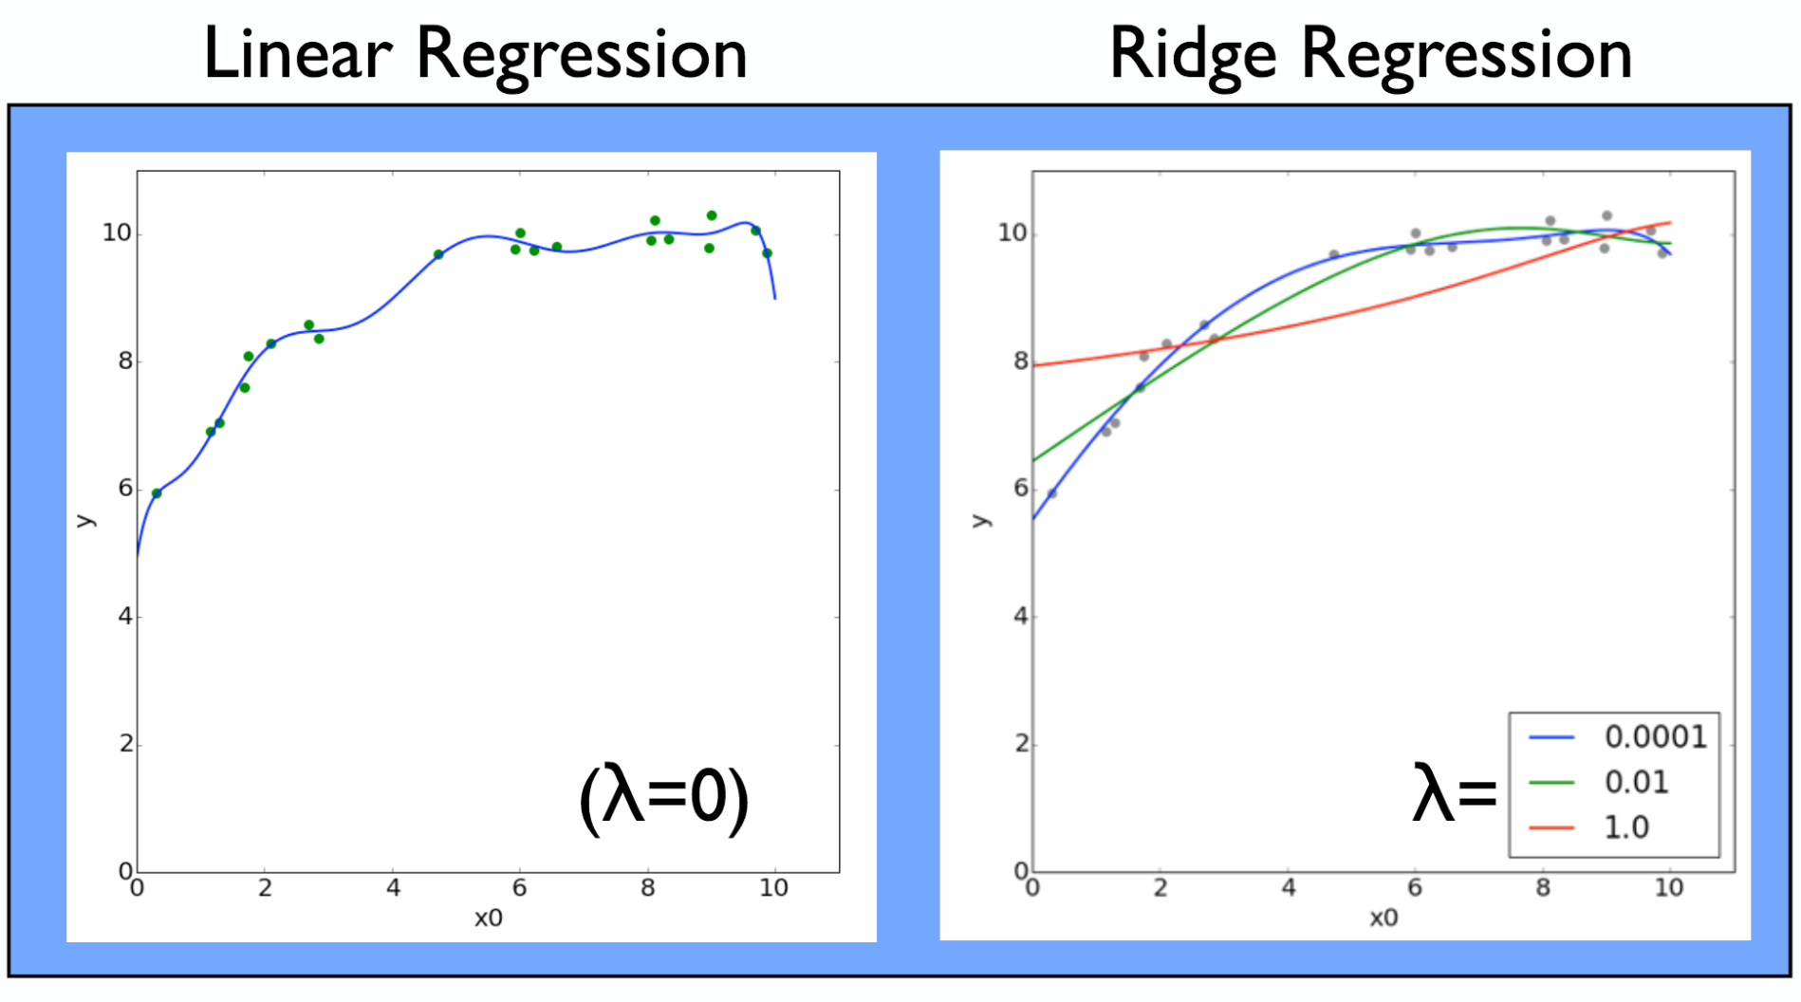
Ridge Regression

Slide 38
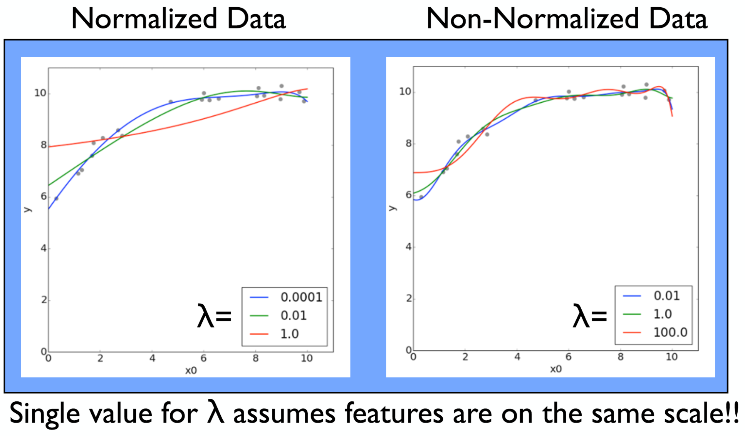
Ridge Regression
Notes:
Notice, the non-normalized data isn’t affected much by the large lambda! This is because the lambda is probably only focusing on one or two large beta values (corresponding to the large features). The other (smaller) beta values don’t get touched much and are free to be anything they please.
Where in the normalized data case, all betas will be punished equally together, so a large lambda will have an effect on all beta parameters.

Slide 39
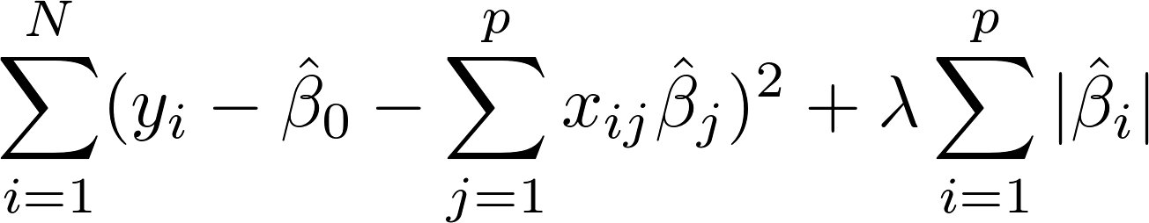
LASSO Regression
(Linear Regression w/ LASSO (L1) Regularization)
We model the world as:
We estimate the model parameters to minimizing:
(same as before)
(the “regularization” parameter)
(absolute value instead of squared)
Notes:
\sum_{i = 1}^{N} (y_i - \hat{\beta}_0 - \sum_{j=1}^{p} x_{ij} \hat{\beta}_j)^2 + \lambda \sum_{i=1}^{p} |\hat{\beta}_i|
Same rules as with ridge: (1) use normalized data, (2) use cross-validation

Slide 40
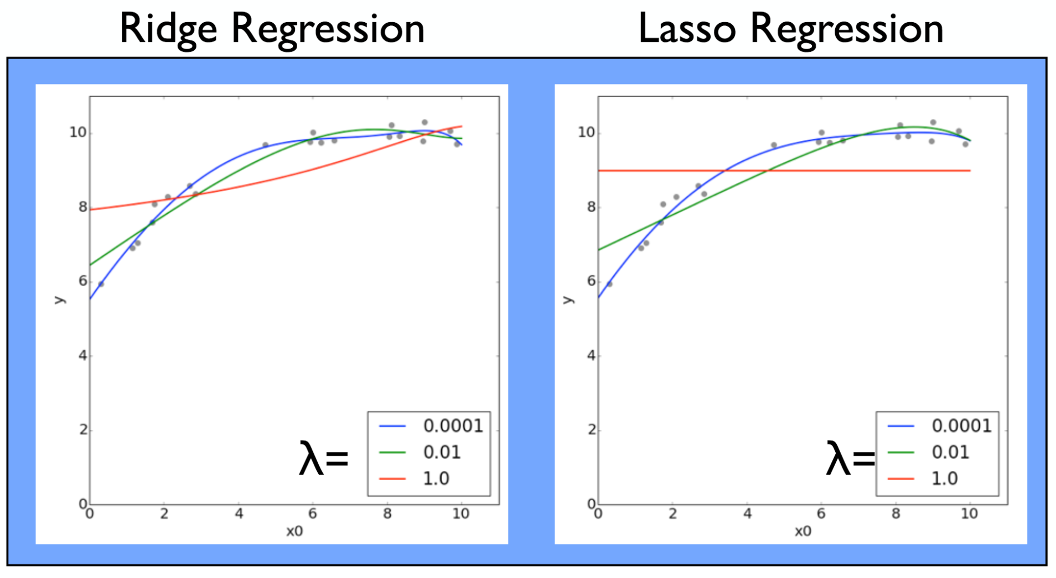
Lasso Regression

Slide 41
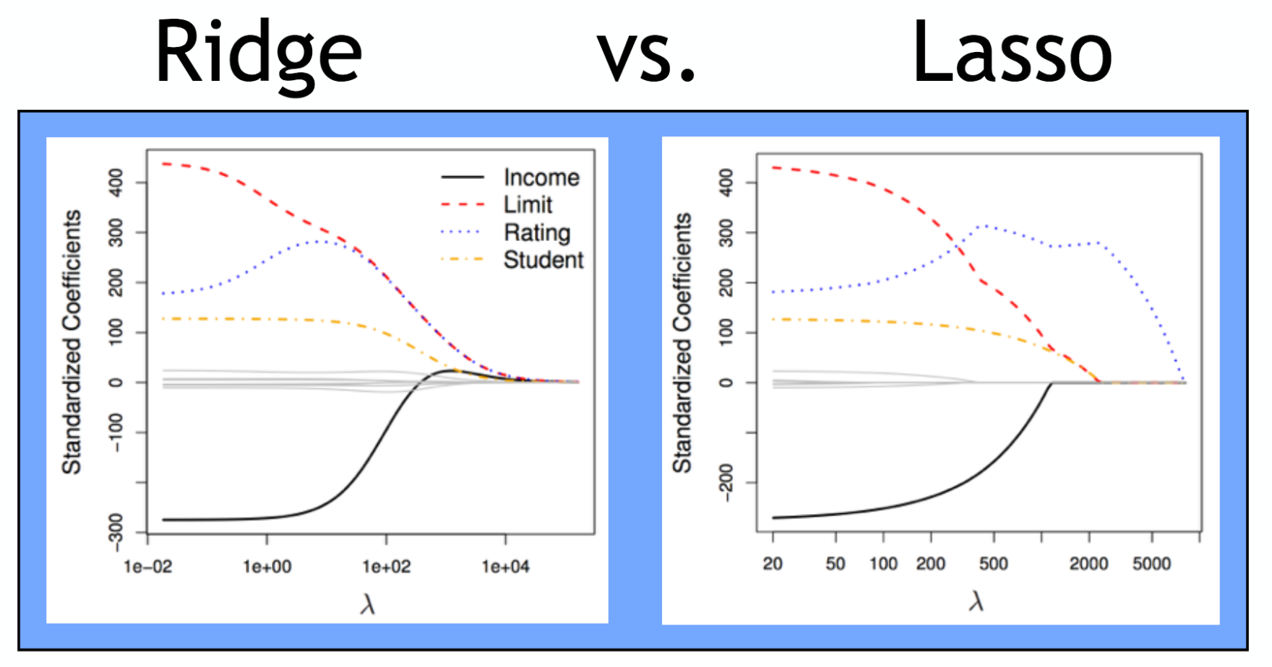
Ridge vs LASSO

Slide 42
Ridge vs LASSO
Ridge forces parameters to be small + Ridge is computationally easier because it is differentiable
Lasso tends to set coefficients exactly equal to zero
This is useful as a sort-of “automatic feature selection” mechanism,
leads to “sparse” models, and
serves a similar purpose to stepwise features selection
Which is better depends on your dataset!
True sparse models will benefit from lasso; true dense models will benefit from ridge.
Notes:
Imaging a lab experiment where we have a bunch of test subjects some with a certain disease and some without. We collect 30k gene expressions for each subject. We can try to fit a predictive model over those 30k gene expressions, but it’d be awesome if our model didn’t actually need all 30k gene expressions. Fitting a lasso model could help us limit the number of gene expressions that need to be sampled in a clinic to test for this disease in the future -- if we had to use all 30k genes to test for this disease in a clinic, it would be too expensive -- it would be way better if it only needed, say, 5 genes.

Slide 43
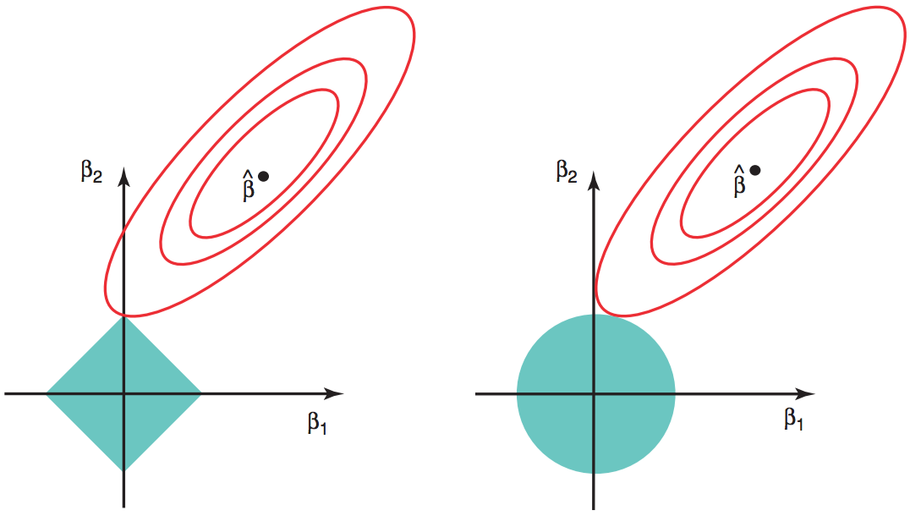
Ridge vs LASSO
LASSO
Ridge
Notes:
The perimeter of the square in LASSO shows equal regularization penalties. The Beta hat shows the optimal beta

Slide 44
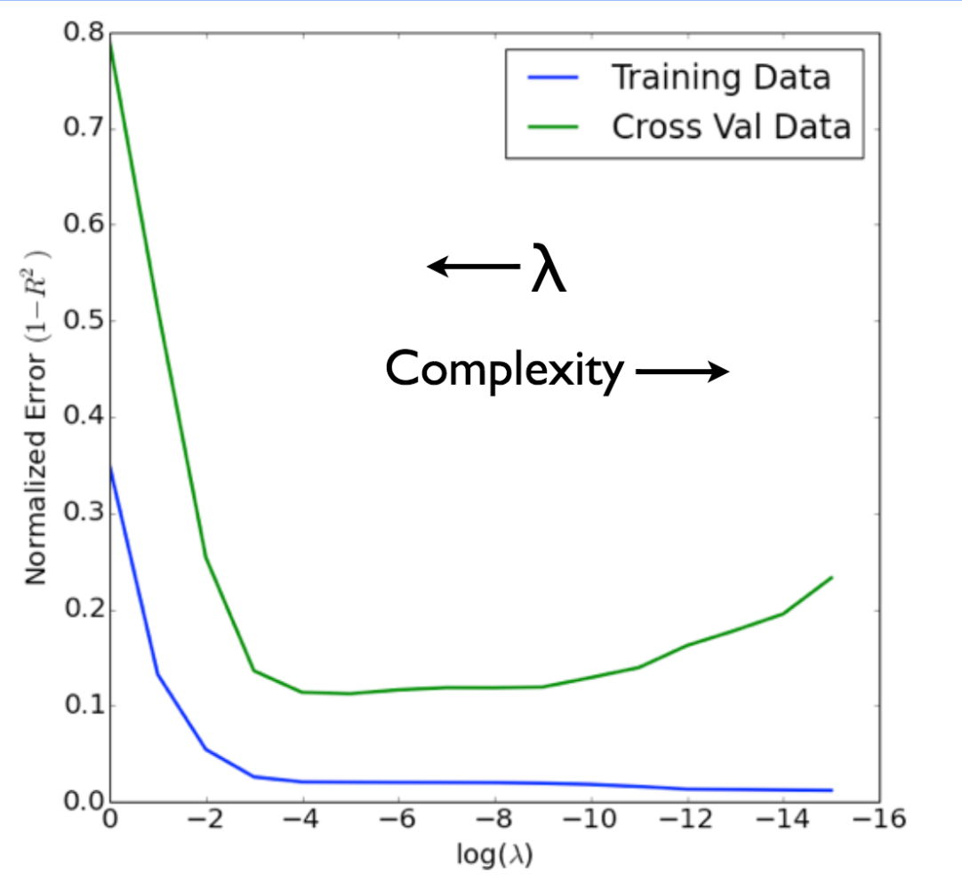
Chose lambda via Cross-Validation

Slide 45
scikit-learn
Classes:
sklearn.linear_model.LinearRegression(...)
sklearn.linear_model.Ridge(alpha=my_alpha, …)
sklearn.linear_model.Lasso(alpha=my_alpha, …)
All have these methods:
fit(X, y)
predict(X)
score(X, y)

